Slide 1
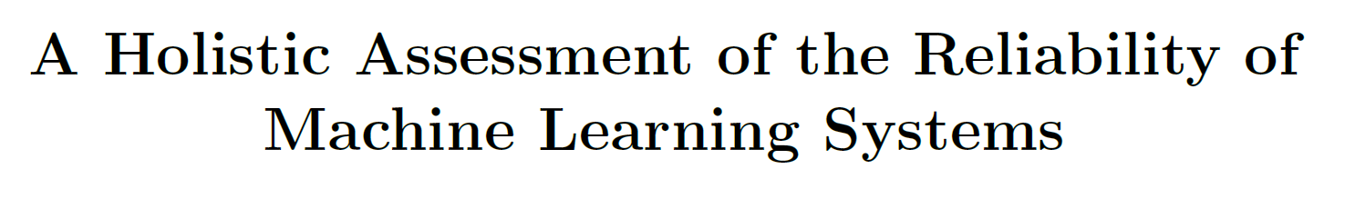
Preprint in 2023 July
Mingle Xu
Jeonbuk National University
2023 Aug 18

Slide 2
Motivation to share this paper
There are many challenges from theory to real-world application.
Interpretability
Reliability (robustness)
Privacy
Security
Ethic
…

Slide 3
Motivation to share this paper
There are many challenges from theory to real-world application.
Interpretability
Reliability (Robustness)
Privacy
Security
Ethic
…

Slide 4
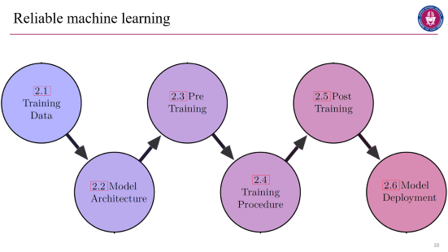
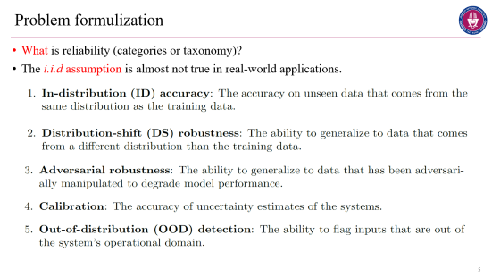
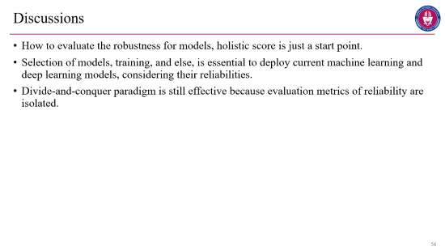
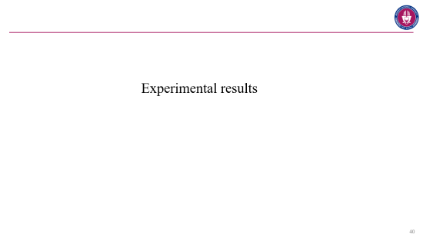
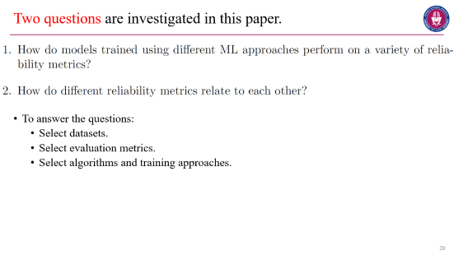
Content
Problem formulation
Taxonomy
Expr setup
Expr results
Discussion

Slide 5
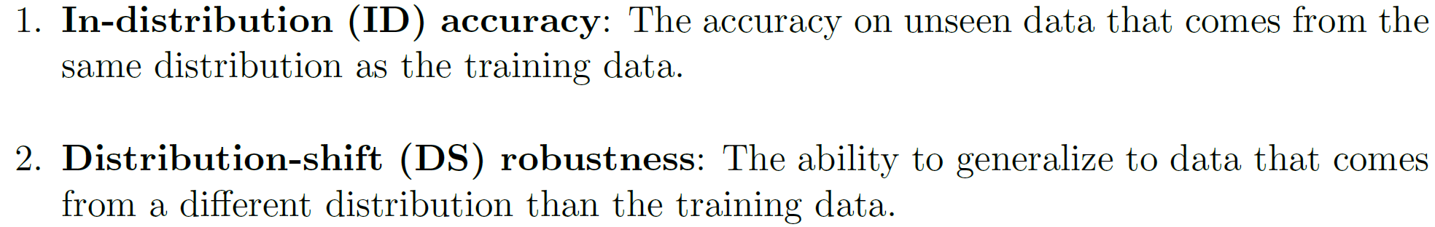
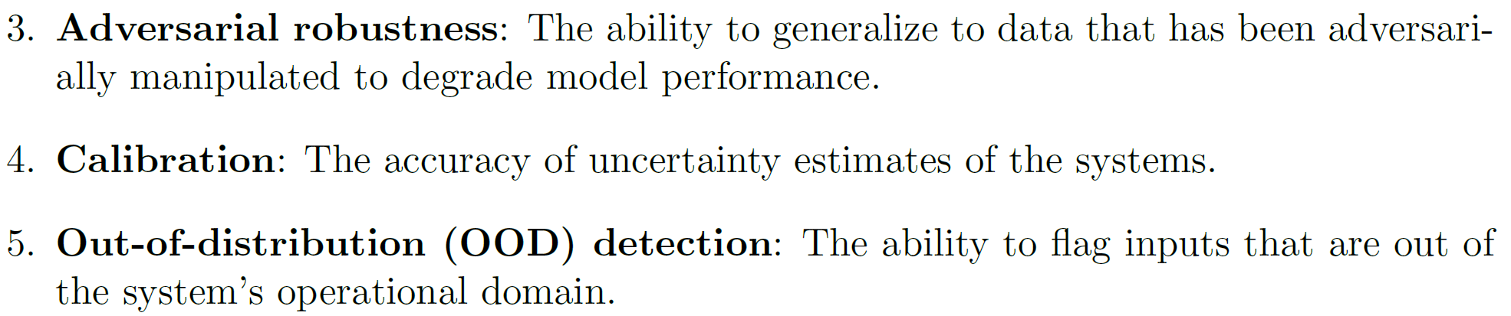
Problem formulization
What is reliability (categories or taxonomy)?
The i.i.d assumption is almost not true in real-world applications.

Slide 6
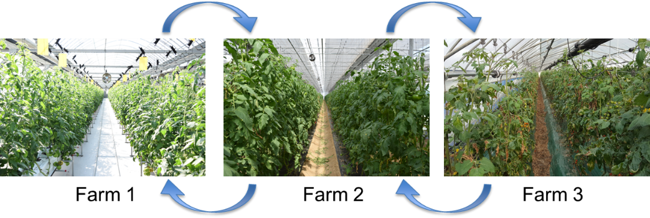
Related terminologies
Domain adaption
Domain generalization

Slide 7
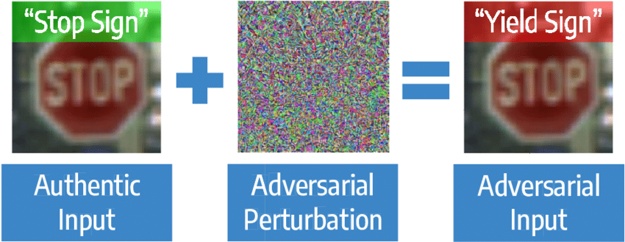

Slide 8
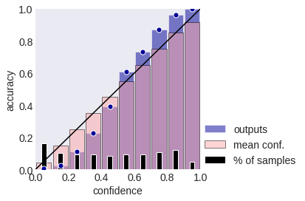
Confidence should align the accuracy.

Slide 9
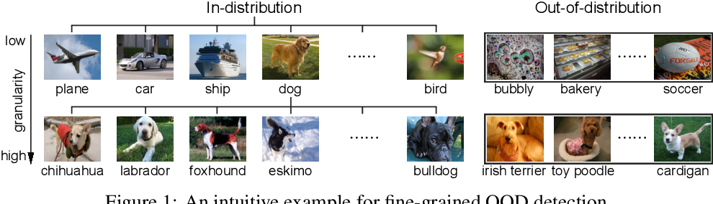
Related terminologies
Open set recognition (OSR)
Open vocabulary detection
Novelty detection
Anomaly detection

Slide 10
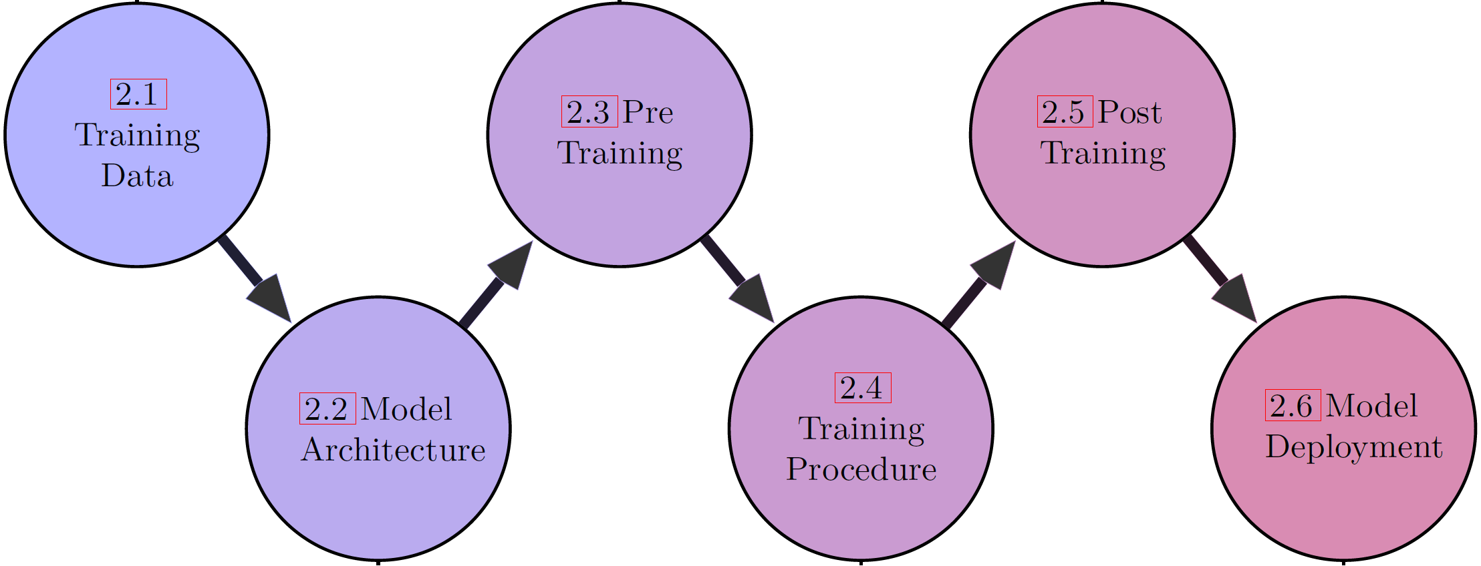
Reliable machine learning

Slide 11
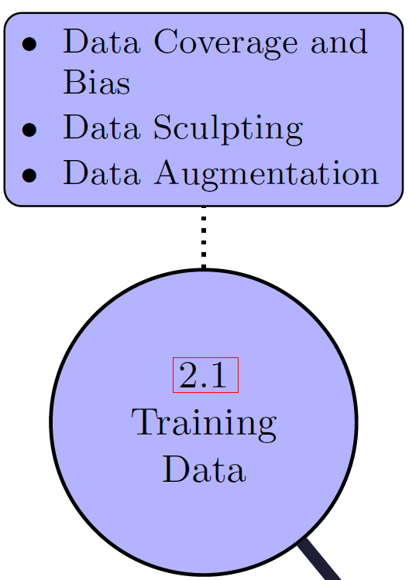
Training data
Quality (adequate), diversity, representativeness (unbiased).
Data sculpting encompasses the selection, cleaning, annotation, and evaluation. Error rate: 0.15% MNIST, 6% ImageNet.
Data augmentation is a widely used technique.

Slide 12
Obtaining a high quality dataset is only one part of creating a good ML model.
Another key design decision is the type of model to use.
It is exactly like our latest idea: embracing limited and imperfect training dataset.

Slide 13
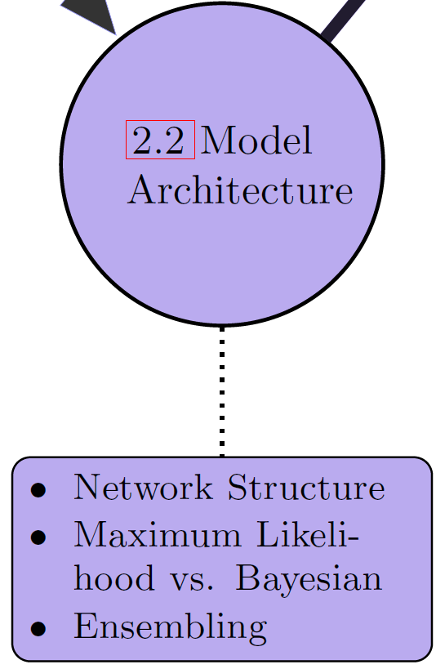
Model architecture
Network structure: CNNs (ConvNeXt), ViT. Model size is important tor performance on downstream tasks.
Maximum likelihood and Bayesian. Bayesian machine learning provides a more natural representation of uncertainty by estimating a distribution over model parameters. Dropout approximates Bayesian inference and can be applied at test time for uncertainty quantification.
Ensemble. Diverse training methodologies create models that specialize in different subdomains of the data and produce increasingly uncorrelated errors. ResNet-50 (IN acc 0.765) + ALIGN-ZS (IN acc 75.5) → boost 7% in acc.

Slide 14
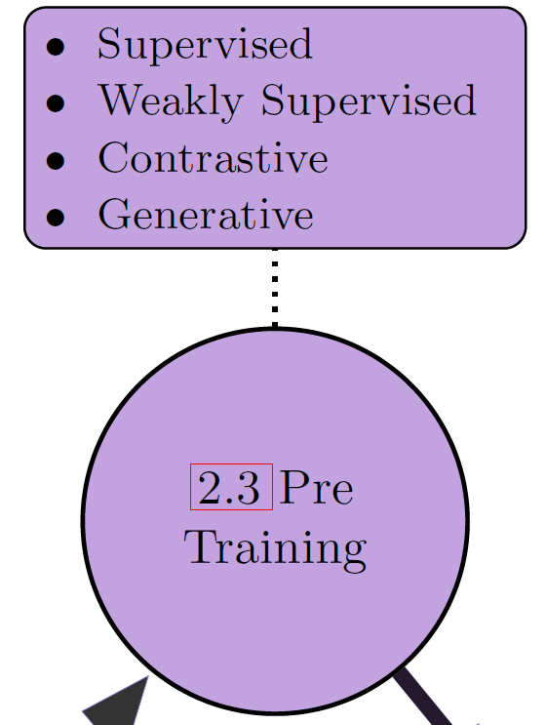
Pre-training to get good initial representation
Supervised. Pretrained model in ImageNet and domain shift. Size of target datasets.
Weakly supervised one involves converting unlabeled datasets into supervised learning tasks, such as predicting relative location of two image patches.
Contrastive one is a self-supervised learning approach that aims to learn useful representations by maximizing agreement between positive samples and minimizing agreement between negative samples, such as CLIP.
Generative one encompasses unsupervised approaches aimed at reconstructing synthetically removed parts of the input data, such as MAE. Input data may be images, features, and multimodal (text).

Slide 15
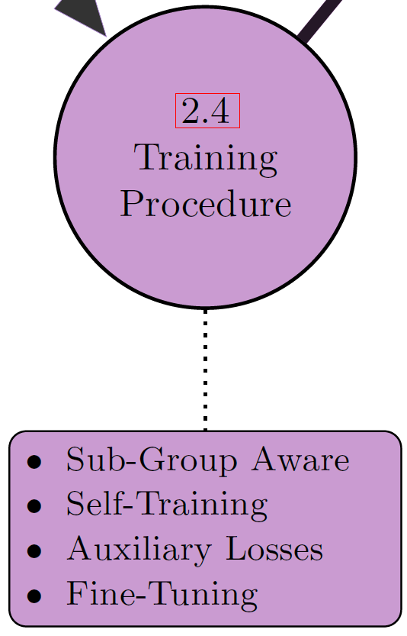
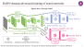
Training
Traditional objective: ERM (empirical risk minimization) with SGD. + additional losses (regularizations) and new optimization skills.
Subgroup-aware training: use domain knowledge, such as DANN.
Self-training on unlabeled data makes pseudo labels iteratively using the predictions of the current models and uses them train models.
Auxiliary and alternative losses.
Fine-tuning is useful not only for in-distribution but also domain-shift and adversarial robustness.

Slide 16
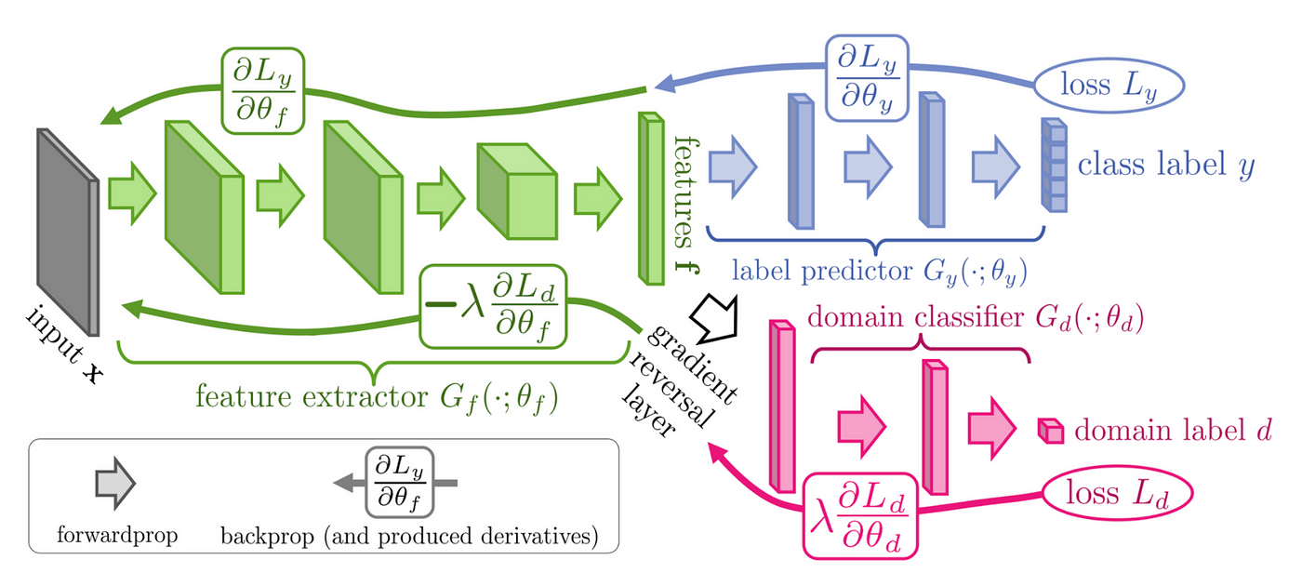
DANN domain-adversarial training of neural networks
Inputs have domain label.
"Domain-adversarial training of neural networks." The journal of machine learning research 17.1 (2016): 2096-2030.

Slide 17
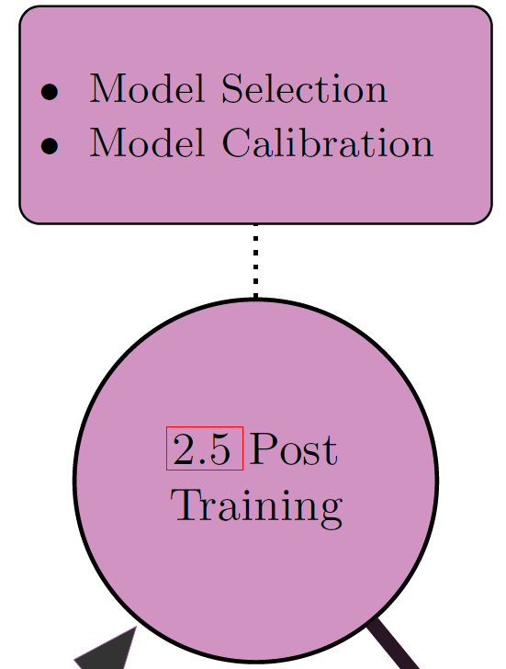
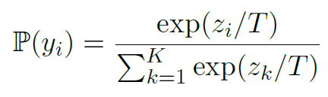
Post-training
After completing training, additional analysis and calibration may be required before a model can be deployed.
Model selection: selecting the most suitable model for deployment can be a challenging task even when multiple models demonstrate similar performance on in-distribution test sets..
Uncertainty calibration. Once a model has been trained, its uncertainty estimates can be modified without affecting the model accuracy, such as temperature scaling.

Slide 18
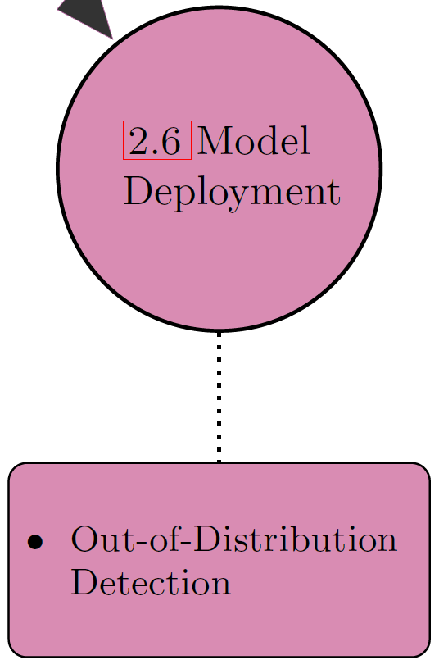
Model deployment
Deployment is a continuous process of monitoring, updating, and improving models based on new data, feedback, and objectives.
Regular assessment is essential since performance tends to degrade over time due to drifts in the data distribution. If the performance drops below an acceptable level, the model should be updated with more recent data.
OOD detection and calibration. OOD samples are assumed to be classified with lower confidence.

Slide 19
Tips, observations, and questions from Mingle
One method may be designed only for one type of the reliabilities.
There are some elusive connections or assumptions between the reliabilities.
No method is proposed aiming for all reliabilities, few for more than one reliability.
Divide-and-conquer or its inverse (possible)?
Is there any method beneficial for all reliabilities or majority of them, such as ensemble and data augmentation?

Slide 20
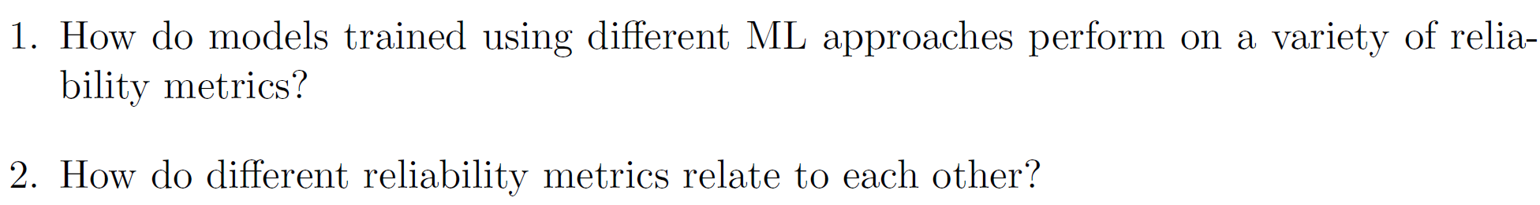
Two questions are investigated in this paper.
To answer the questions:
Select datasets.
Select evaluation metrics.
Select algorithms and training approaches.

Slide 21
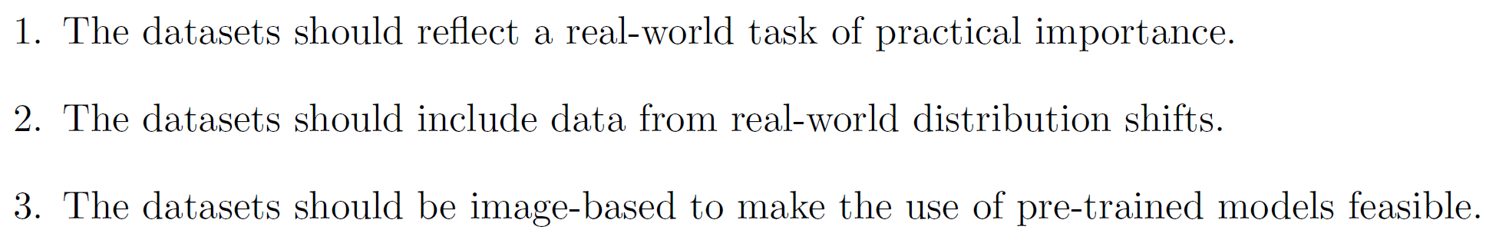
Criteria to choose datasets

Slide 22
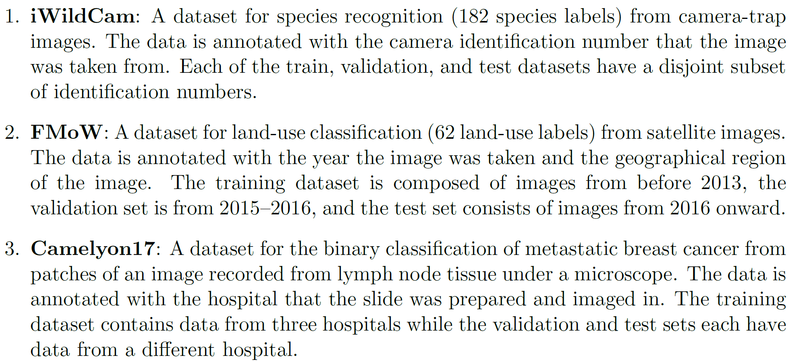
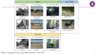
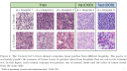
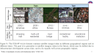
Chosen datasets
From a distribution shift benchmark.

Slide 23
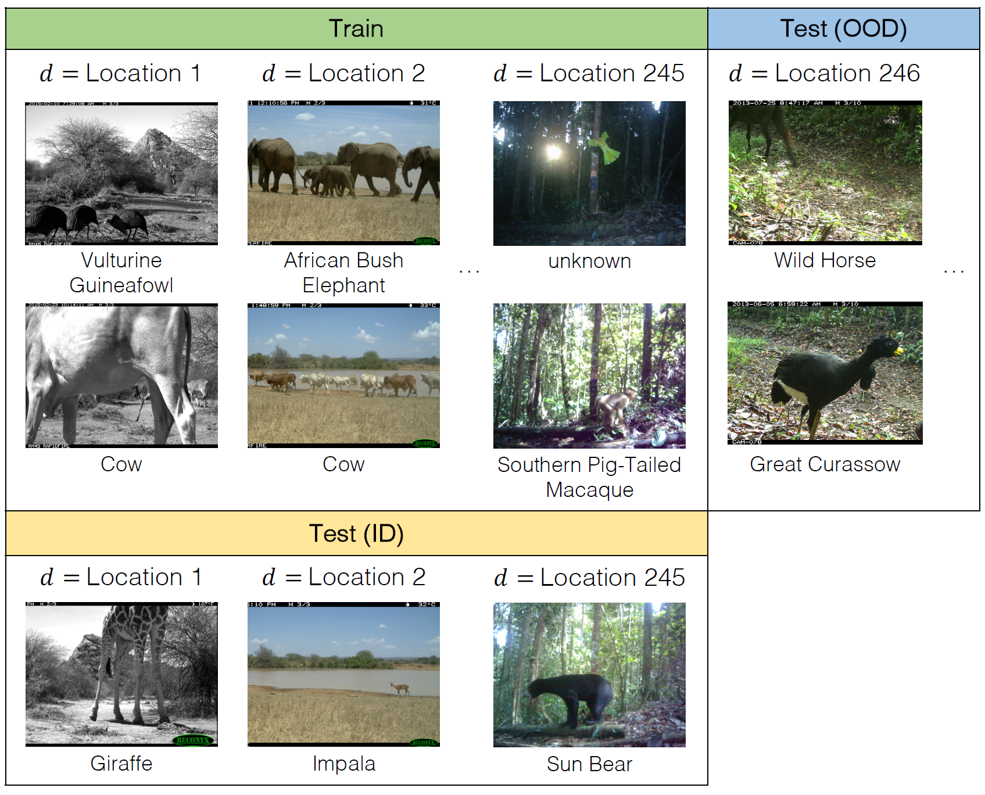
"Wilds: A benchmark of in-the-wild distribution shifts.“ ICML 2021

Slide 24
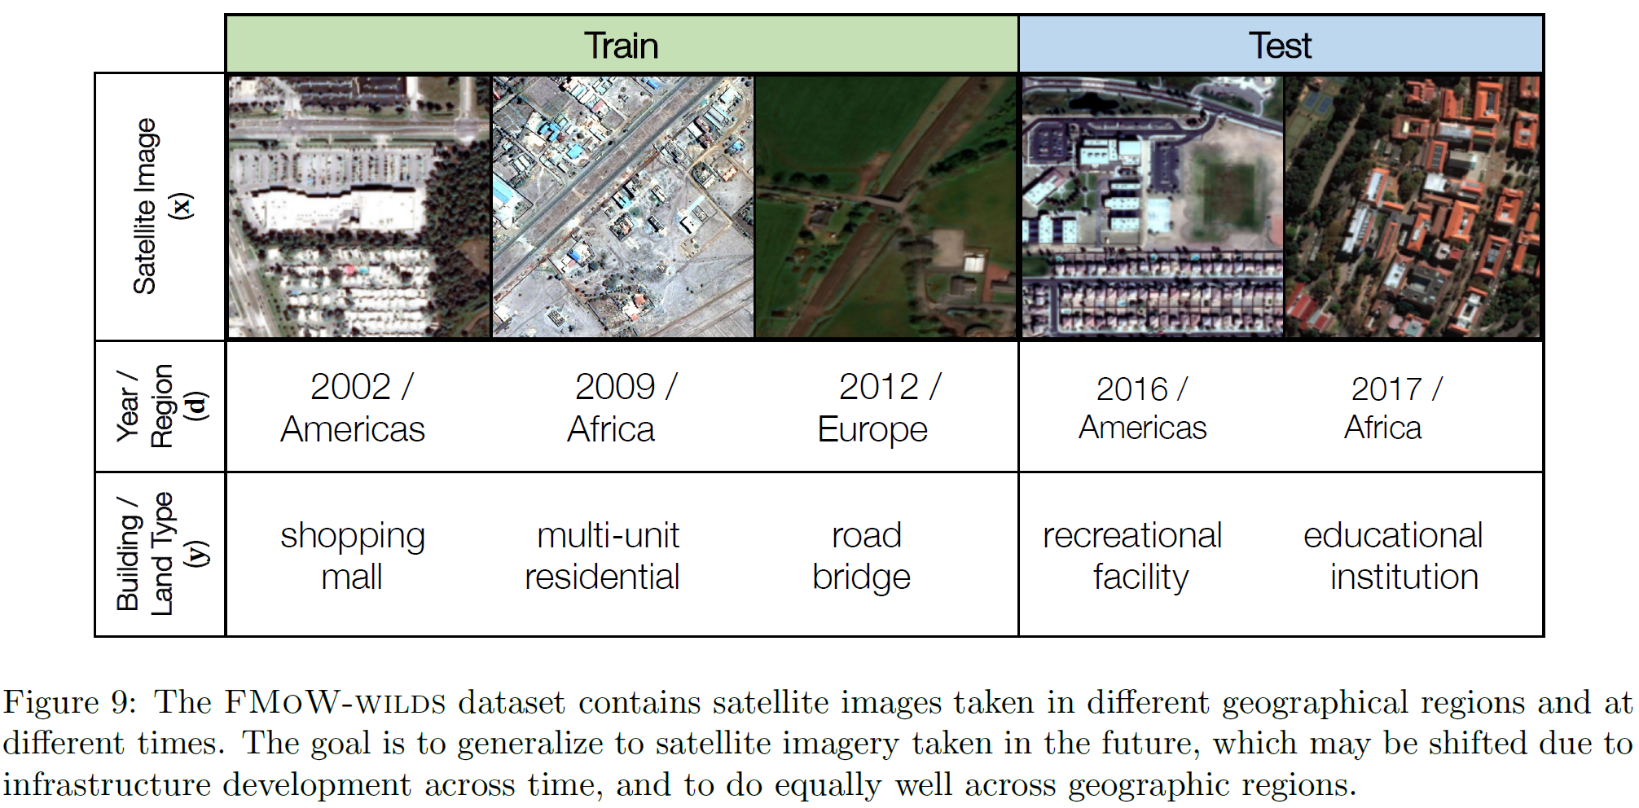
"Wilds: A benchmark of in-the-wild distribution shifts.“ ICML 2021

Slide 25
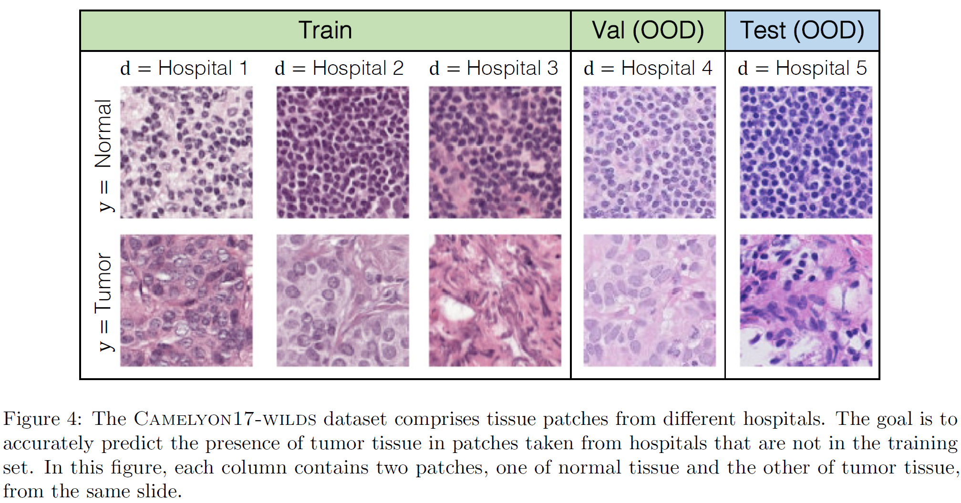
"Wilds: A benchmark of in-the-wild distribution shifts.“ ICML 2021

Slide 26
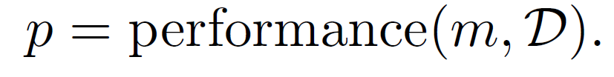
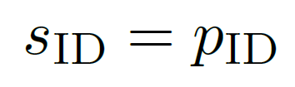
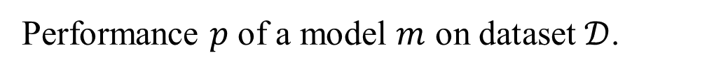
Evaluation metrics
Five tasks.
Score $s∈[0, 1]$, larger values are always preferable.
Performance $p$ of a model $m$ on dataset $𝒟$.
ID: In-distribution performance
Top-1 accuracy

Slide 27
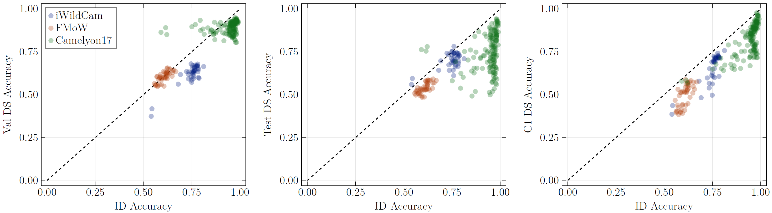
Distribution shift robustness
Violations towards the iid assumption
Synthetic distribution shift, such as common image corruptions and perturbation.
Natural distribution shift, arising from re-collecting data, changing data collection criteria, or other real-world changes in the deployment environment.
Understanding: test accuracy drops with synthetic corruptions.
Empirical observation: strong correlation between in-distribution generalization and distribution-shift generalization, accuracy on the line. (Also for other robustness).

Slide 28
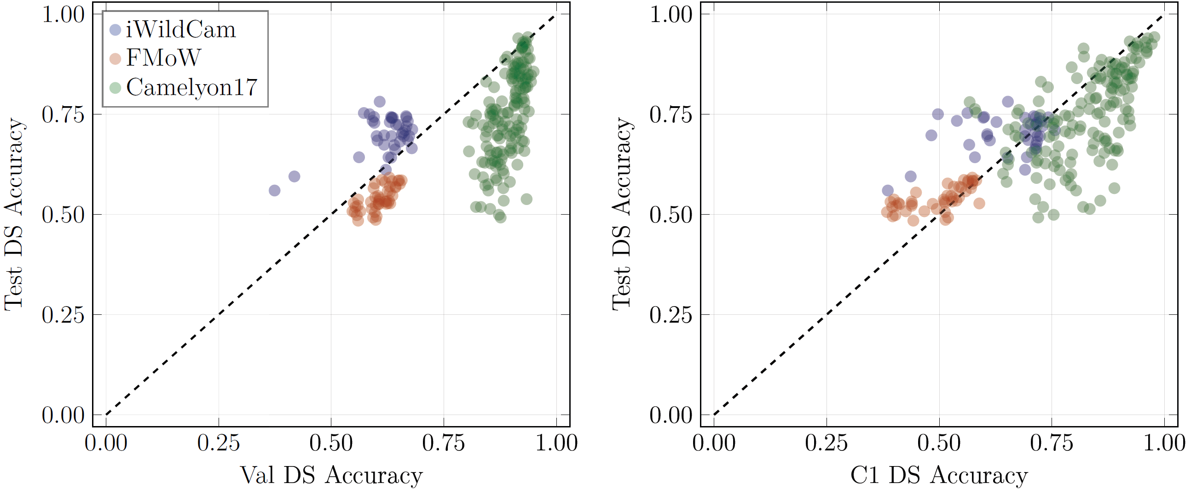
Strong correlation is not always.
Type of distribution-shift.
Magnitude of the distribution-shift.
Does robustness to one distribution shift imply robustness others? NO.

Slide 29
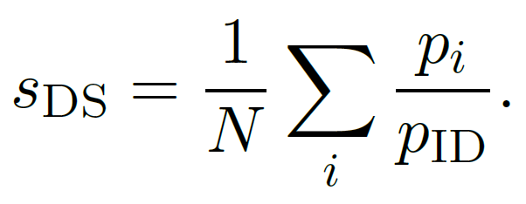
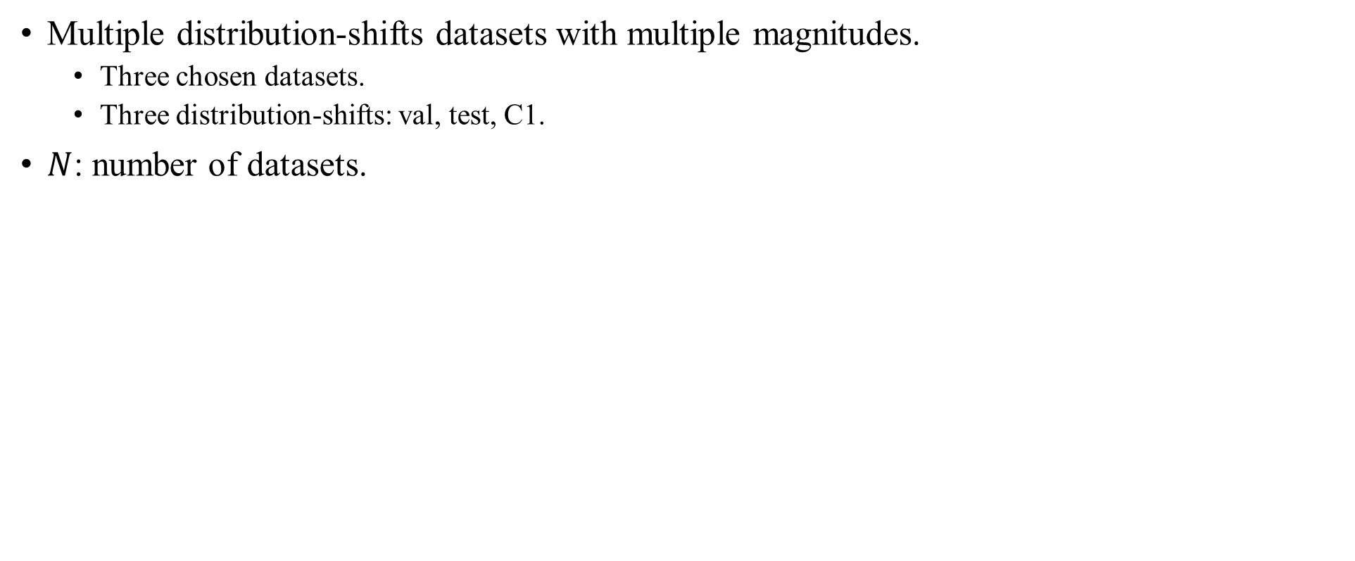
Evaluation metric for distribution-shift robustness
Multiple distribution-shifts datasets with multiple magnitudes.
Three chosen datasets.
Three distribution-shifts: val, test, C1.
$N$: number of datasets.

Slide 30
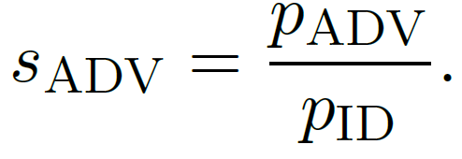
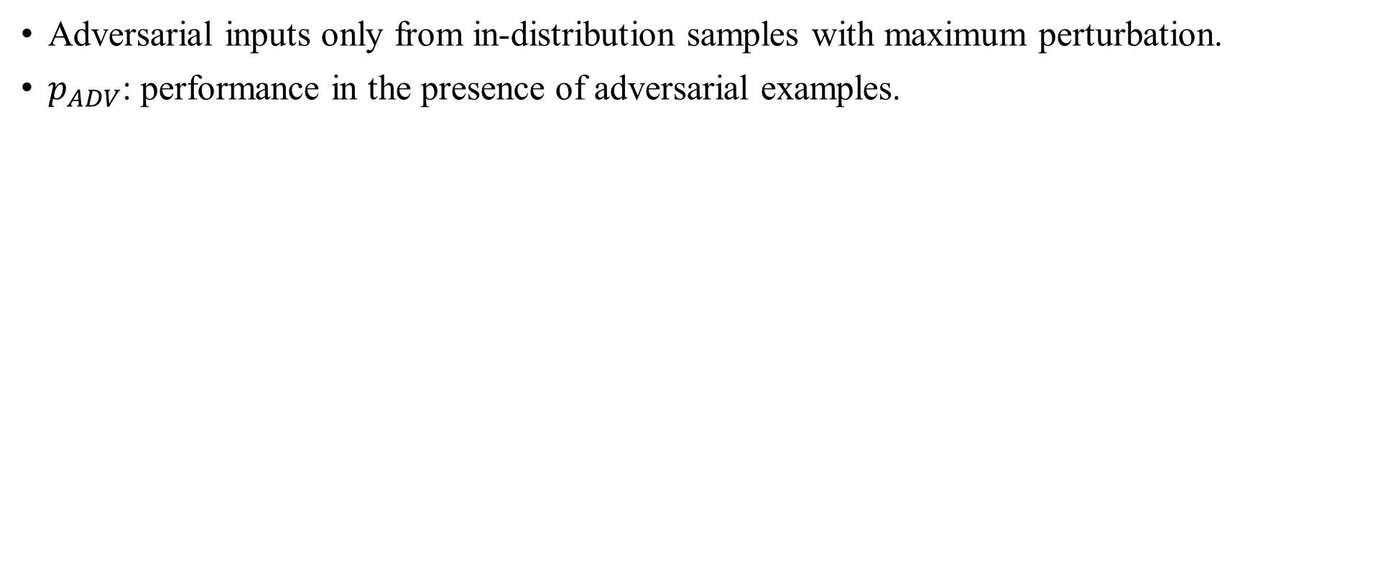
Adversarial robustness
Adversarial inputs only from in-distribution samples with maximum perturbation.
$p_{ADV}$: performance in the presence of adversarial examples.

Slide 31
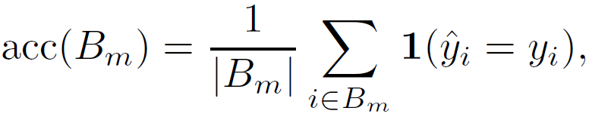
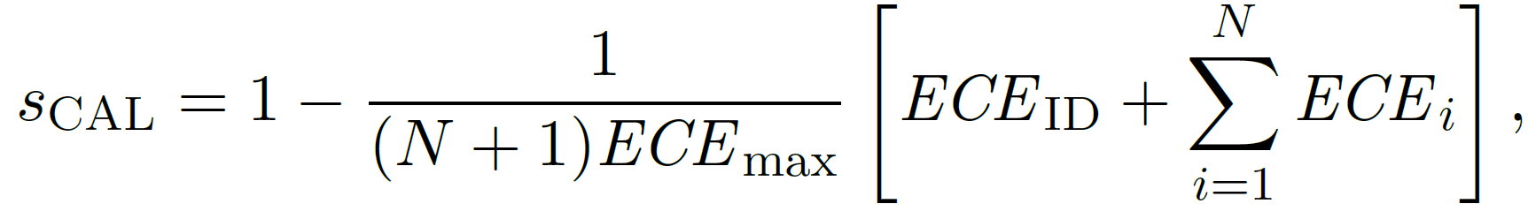
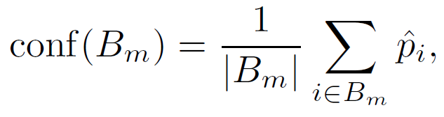
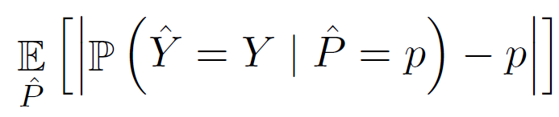
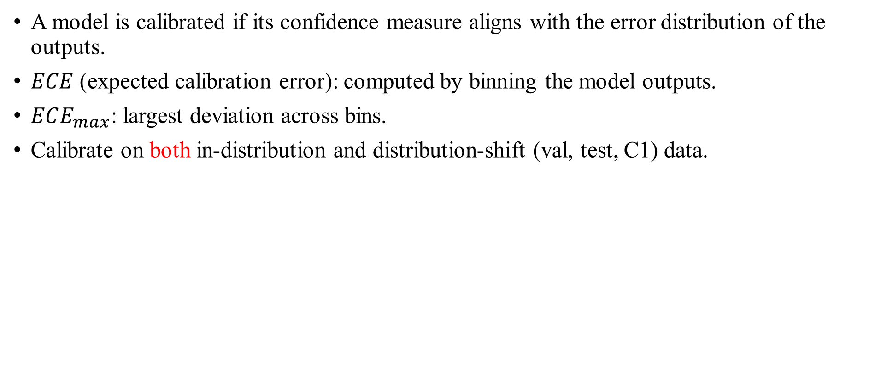
Calibration
A model is calibrated if its confidence measure aligns with the error distribution of the outputs.
$ECE$ (expected calibration error): computed by binning the model outputs.
$ECE_{max}$: largest deviation across bins.
Calibrate on both in-distribution and distribution-shift (val, test, C1) data.
"On calibration of modern neural networks.“ ICML 2017

Slide 32
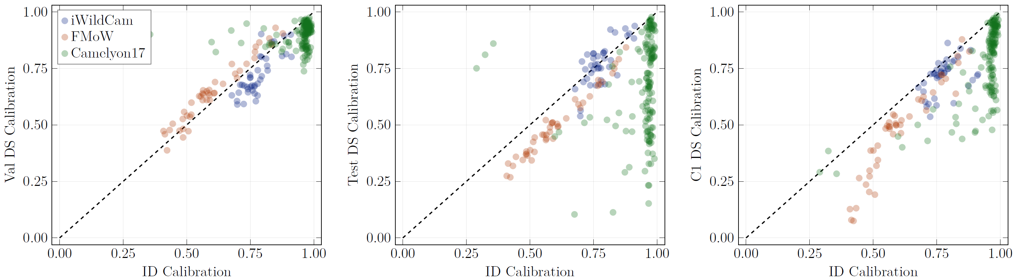
Calibration drops under distribution shifts.
In-distribution and distribution shifts calibrations correlate significantly in iWildCam but not strong on Camelyon17.

Slide 33
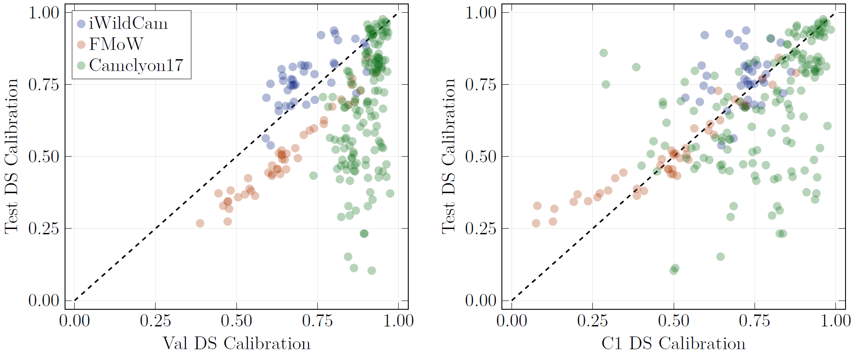
Correlation is weaker between distribution shifts than it is to the in-distribution.

Slide 34
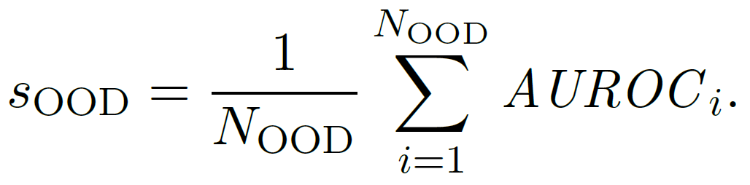
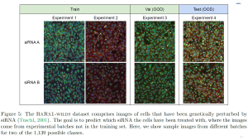
Out-of-distribution (OOD) detection
Combine diverse OOD datasets into a single OOD dataset.
ID dataset
OOD dataset: two other datasets of the three chosen ones, Gaussian noise, RxRx1.
AUROC, threshold-free.
Why average AUROCs on multiple OOD detection algorithms?

Slide 35
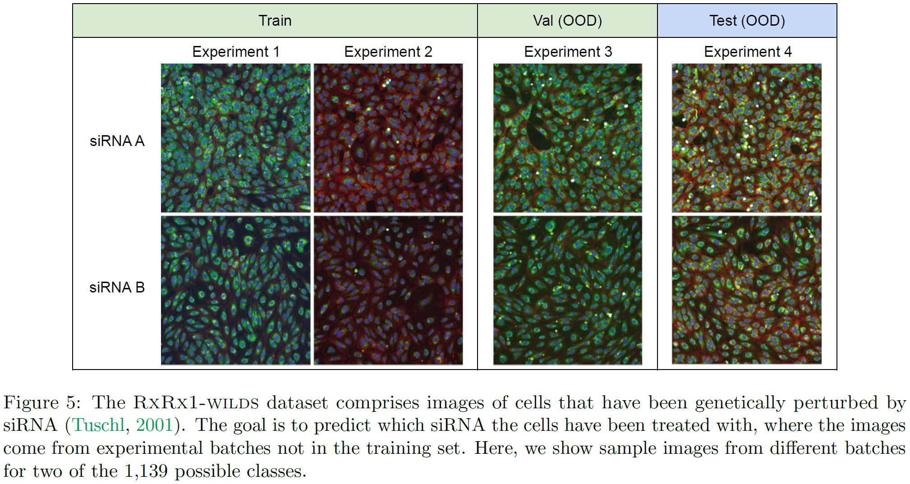

Slide 36



Correlation of methods exist but substantially diverse.

Slide 37


Holistic reliability score
This value may lose fine-grained detail about the individual performance characteristics of a model.

Slide 38

Selection of algorithms and training approach
Data augmentation: AugMix, RandAugment.
Adversarial data augmentation.
Fine-tuning from pre-trained models.
Model ensemble.
Temperature scaling.
Hyperparameters were selected by choosing the best configuration from 10 random hyperparameter samples.
234 pre-trained models are publicly available in WILDS benchmark.
Train 287 models.
Analyze more than 500 models.

Slide 39

AugMix layers a series of simple image augmentation operations in concert with a consistency loss and has been shown to halve the error rate of corrupted CIFAR-10.
"Augmix: A simple data processing method to improve robustness and uncertainty.“ 2020 ICLR.

Slide 40
Experimental results

Slide 41

Data augmentation
 | ID | DS | ADV | CAL | OOD | HR
Adversarial | ↓ | d. dset | ↑↑ | d. dset | ↓↓ | d. dset
AugMix |  |  |  |  |  | ↑↑
RandAug |  |  |  |  |  | ↑↑
Each circle is a model.
Blue band shows the range of the ERM baseline with the dashed line giving the average.
Up and down arrow suggest reduce and increase the scores. One-arrow denotes slightly, and two-arrow denotes significantly.
d. dest denotes depending on dataset.
Think about the highlighted arrows.
iWildCam dataset is default.

Slide 42


Slide 43

Model ensembling
The gains appear to diminish as the number of models increase.
 | ID | DS | ADV | CAL | OOD | HR
Ensembling | ↑↑ | ↑↑ | ↑↑ | ↑↑ | ↔ | ↑↑
s

Slide 44

Pretraining algorithm
SWAG: weak supervision by constructing a dataset of 3.5 billion images from Instagram, where image hashtags serve as the image labels.
 | ID | DS | ADV | CAL | OOD | HR
MAE | ↓↓ | ↑↑ |  | ↑↑ | ↑↑ | ↑↑
CLIP | ↓ | ↑↑ |  | ↑↑ | ↑↑ | ↑↑
SWAG | ↓ | ↑↑ |  | ↑↑ | ↑↑ | ↑↑
Super. IN1k | ↓↓ | ↑↑ |  | ↑↑ | ↑↑ | ↑↑
s

Slide 45


Slide 46

Pretraining model architecture
In the context of supervised pre-training.
All ViTs and ConvNeXt have superior DS, CAL and OOD performance.
s

Slide 47

In other datasets, only ViT and ConvNeXt have significant DS.

Slide 48


Model size
Larger model show slight improvements in almost all categories.
Largest ViTs consistent good performance.
s

Slide 49

Sub-group aware training
Do not improve DS robustness, but they are designed for DS.

Slide 50

Unlabeled training data
Small improvement in DS and CAL, other robustness are not changed.
s

Slide 51

Temperature scaling
No strong effect on ADV nor OOD.
CAL is improved generally.

Slide 52

Distribution of scores and summary of improvements
Ensembling has the biggest improvement on ID and CAL.
Fine-tuning has the biggest on DS, OOD, and HR.
Adversarial training was able to consistently achieve higher levels of ADV.

Slide 53

Distribution of scores and summary of improvements
Extra loss functions are the minimal ones.

Slide 54

Metric comparisons and correlations
No significant correlations in the evaluation metrics.
A positive correlation between DS and CAL for all three datasets.
A weak negative correlation between ID and ADV.

Slide 55
We should have enough understandings to explain these empirical observations.

Slide 56
Discussions
How to evaluate the robustness for models, holistic score is just a start point.
Selection of models, training, and else, is essential to deploy current machine learning and deep learning models, considering their reliabilities.
Divide-and-conquer paradigm is still effective because evaluation metrics of reliability are isolated.

Slide 57
Some algorithms lead to improvement on just one of the metrics and sometimes at the cost of others, such as adversarial training.
Temperature scaling always contributes calibration and leaves the other metrics unchanged.
Learning from unlabeled data (in-distribution) lead to modest improvements in DS and sometimes CAL, but the improved values vary in different datasets.
Ensembling is effective for all metrics, except for OOD.
Fine-tuning is very good.

